Slide 1


Jeff Kimpel: Faculty Member, Director, Dean, and Senior VP & Provost
John T. Snow
Regents’ Professor of Meteorology
The College of Atmospheric and Geographic Sciences

Slide 2
Contributions
Vision → a “weather enterprise” for Oklahoma
Leadership → realizing the vision

Slide 3


Vision → A “weather enterprise” for Oklahoma
Communicate, Coordinate, Collaborate → Oklahoma Weather Center
From Collocation to Consolidation
  OSF and OKC WFO to Adair Bldg on North Base
  National Weather Center
  National Weather Radar Testbed/Phased Array Radar Project
Foster Private Sector Meteorology

Slide 4











































Slide 5
Leadership – Realizing the vision
What did Jeff do best?
  Articulated the Vision in ways that caused others to buy in
  Created a collegial, supportive environment wherein education, research and scholarship, and outreach to the wider community could flourish.
    Some results and consequences:
      -- students integrated throughout the weather enterprise
      -- adjunct faculty program in the School of Meteorology
      -- research linkages between NSSL and the University weather and climate programs
  Hired outstanding faculty

Slide 6
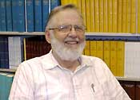
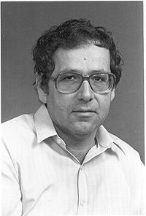


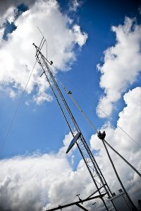

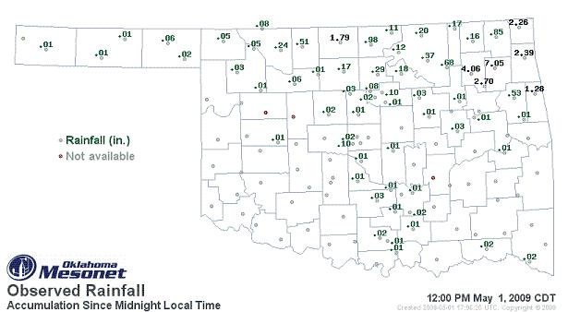
Outstanding Hires
Doug Lilly + Tsvi Gal Chen
Ken Crawford

Slide 7
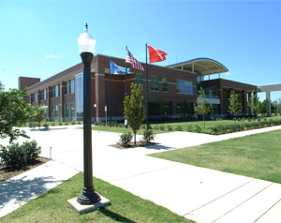
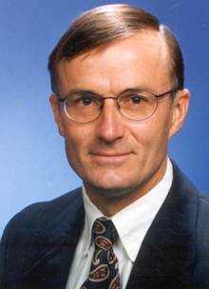
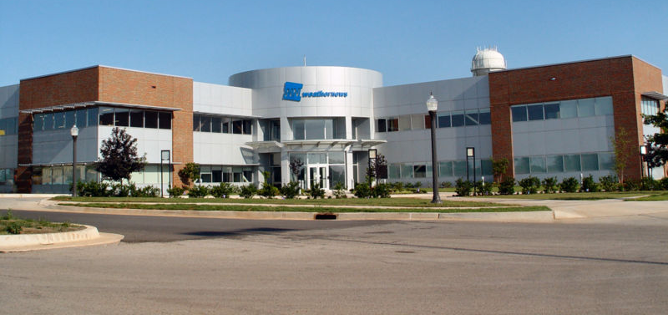
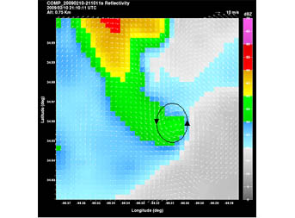
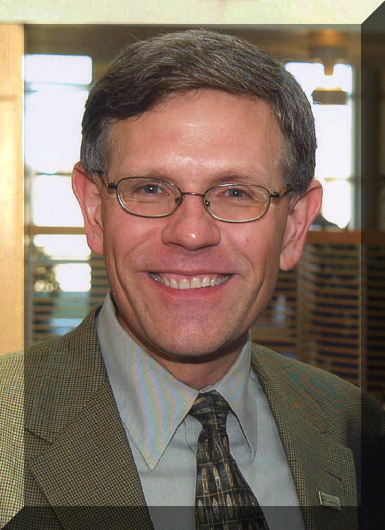
Outstanding Hires
T.H. Lee Williams
Kelvin Droegemeier

Slide 8
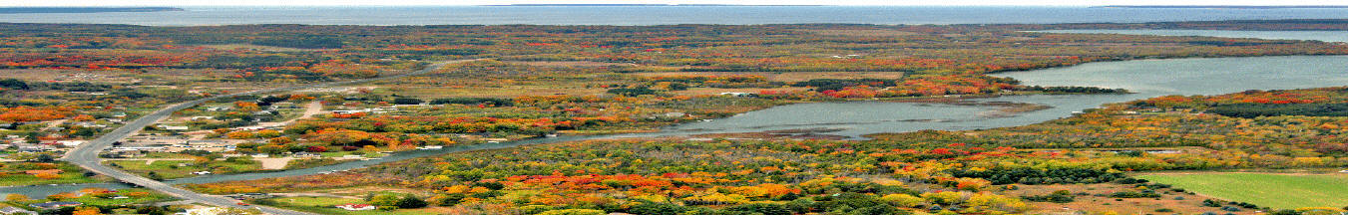

Well Done!
Congratulations!
Best Wishes!

